Slide 1
ABSTRACT
Police has always been a means of protecting people even in the remote area of this crowded world.So, in order to provide security to the people we have created a Police Station Database System which provides a secure interface that the users can experience. The user-friendly environment provides user-registration for the first-time to access the database related to the civilians and police can access all the database which only related to their respective police station. And admin can access the all the database about all police station. Once logged in, users can access all his details which are provided as many times they want.
The police station database is also provided with the option to add FIR, so that user can add their profile details and file the FIR.They can also view the list of FIRs filed by them through their account. The user can also check the status of the FIRs which are done by them(pending or resolved).Finally, when the users want to exit from the police database, we have provided a logout option so that user can log out safely by clicking logout button.
II

Slide 2
Table of Contents
Acknowledgment…….……………………………....…………………………I
Abstract……………………………..……………...…………………………..II
Table of Contents……………………..…………………………...…….III,IV
List of Figures……...………….…………………………………………...…….V
List of Tables………………….………………...……………………...……….VI
Chapter 1 ……………………..…………………………………..…………..1
Introduction………………………………………………………..….…1
1.1 Problem Statement ………………………………………………………………..1
1.2 Objectives ………………………………………………………………………….1
1.3 Scope ……………………………………………………………………………….1
Chapter 2…………………………………………...…………………………2
Literary Survey………………………………………………….....……2
2.1 Traditional File Systems……………………………..……………………….…..2
2.2 Pros and Cons of the Traditional Approach………………………………….....2
2.3 Downfall of Traditional Management System…………………………………..4
2.4 Introduction to the Database Management System…………………………….4
2.5 Indicative areas for the use of a DBMS……………………………………….....5
2.6 Advantages of a DBMS………………………………...……………………....…5
2.7 Components of a DBMS………………………………………………………......6
Chapter 3……………………………………………………………………...7
System Requirements………………………………………...................7
3.1 Hardware Requirements…………………………………………………….…...7
3.2 Software Requirements…………………………………………………………...7
III

Slide 3
Chapter 4………………………………………………………................….8
4.1 System Design…………………...…………………………………......8
4.2 ER Diagrams……...……………………………………………………………….…..9
Chapter 5………………………………………...…………………….…..10
Implementation….………………………………………………….....10
5.1 HTML5………………...………………………………………………………10
5.2 PHP……………………………………………………………….……………11
5.3 SQL(Structured Query Language)………….……………………………….12
5.4 Code Snippets…………………………………………………………….……12
Chapter 6…………………………………………………………………..27
Snapshots…………....…………………………………….………..…27
Fig 6.1 The Login Page.……….…………….....………………………….....……27
Fig 6.1 The Register Page.………..…………………………………..….…...…..27
Fig 6.2 The Home Page……..…………………………………………….....……28
Fig 6.3 User Home Page.……….…….……..…………………………..……...…28
Fig 6.4 The Search Page.……….……..…………………………………….....….29
Fig 6.5 Admin FIR Page………..……………….…………………………..…….29
Fig 6.6 Add Police…...……….………......…………………………………….….30
Fig 6.7 Admin Edit……...……….……..……………………………………........30
Fig 6.8 Add FIR.………...……….……..……………………………………........31
Fig 6.9 Add Police…..…...……….……..……………………………………........31
Fig 6.10 Tables…..…..…...……….……..……………………………………........32
Chapter 7…………………………………………………………..........…35
Conclusion…………..……………………………………………………...35
References……………………………………………….....................36
IV

Slide 4
List of Figures
Fig No. Description Page No.
Fig 2.1 Components of a DBMS.……….……..…………………………………………..6
Fig 4.1 Schema Diagram……….……….……..…………………………………………..8
Fig 4.2 ER Diagram for Police Database……..…………………………………………..9
Fig 6.1.1 The Login Page.……….…………….....…………………………………………27
Fig 6.1.2 The Register Page………..…………………………………..…………………..27
Fig 6.2 Admin Home Page…..………………………………………………....…………28
Fig 6.3 User Home Page……..……….……..…………………………..…………..……28
Fig 6.4 Admin Search Page.…………..………………………………………………….29
Fig 6.5 User Search Page..……..……………….……………………………………….29
Fig 6.6 Admin Edit Page.……….………......……………………………...…………….30
Fig 6.7 User Edit Page.……….………...………………………………………………...30
Fig. 6.8 Add Fir Page.….............……..………………………………………...31
Fig. 6.9 Add Police Page.…….…...…....………...……………………………...31
V

Slide 5
List of Tables
Table No. Description Page No.
Table 6-1 FIR Table.……….……..………………………………...…………….……31
Table 6-2 FIR-details Table.……….……..…………………………………….…..….31
Table 6-3 Policemen Table.………..……………………………….……….……...…..32
Table 6-4 Police Station Table.……….……………………………...………………...32
Table 6-6 Users Table.……….……..…………………………………………………..33
VI

Slide 6
Chapter-1
Introduction
1.1 Problem Statement
Police is appointed by administration department, and their job is to provide safety to the civilians but in order to reach the problems to the police station efficiently, they require a platform where they can store their FIR with all its required details. We provide that platform which helps both user and the policeman for getting informations regarding the FIR registered by the user.
1.2 Objectives:
The aim of this project, Police Database System is to meet the following objectives:
First thing is to provide a great experience to the user and to provide the police services quickly and effectively.
Other thing is to provide a platform for the policeman where they can provide their services, we deploy those FIR in our database and help them to reach all those policeman to all our users across the world.
The admin who require a particular FIR can search the details by entering the FIR_id to get required details about the particular FIR to check either it is pending or resolved.
Final ultimate objective is to provide a interactive and user secured environment where user can easily fetch all the FIR from the database without any delay and to provide a best user experience and to reach the users all over the world.
1.3 Scope:
The scope of our project is to ensure all the FIR are resolved as soon as it is done by civilians to provide a better security in this crowded world. And to make them to feel free and secure in society.This project is also concerned with the policeman that he can access all and every details about the user and can take action against it. This is best way to provide result status to users.
Dept. of CSE, SJBIT
2019-20
Page 1

Slide 7
Chapter-2
Literary Survey
2.1 Traditional File System
In the early days of computing, data management and storage was a very new concept for organizations. The traditional approach to data handling offered a lot of the convenience of the manual approach to business processes (e.g. handwritten invoices & account statements, etc.) as well as the benefits of storing data electronically.
The traditional approach usually consisted of custom built data processes and computer information systems tailored for a specific business function. An accounting department would have their own information system tailored to their needs, where the sales department would have an entirely separate system for their needs.Initially, these separate systems were very simple to set up as they mostly mirrored the business process that departments had been doing for years but allowed them to do things faster with less work. However, once the systems were in use for so long, they became very difficult for individual departments to manage and rely on their data because there was no reliable system in place to enforce data standards or management.
Separate information systems for each business function also led to conflicts of interest within the company. Departments felt a great deal of ownership for the data that they collected, processed, and managed which caused many issues among company-wide collaboration and data sharing. This separation of data also led to unnecessary redundancy and a high rate of unreliable and inconsistent data
2.2 Pros and Cons of the Traditional Approach
Pros
Simple
Matched existing business processes and functions

Slide 8
Police Database System
Literary Survey
Companies were not as interested in funding complicated information systems
Initially low-cost
Early computing was not viewed as beneficial for large funding
Systems were designed to be cheap in order to save on cost
Cons
Separated ownership
Business functions had a high sense of data ownership
Departments unwilling to share data for fear of minimizing their superiority
Unmanaged redundancy
Multiple instances of the same data appeared throughout various files, systems, and databases
Information updated in one place was not replicated to the other locations
Disk space was very expensive, and redundancy had a big impact on storage
Data inconsistency
Redundant data stored in various locations was usually never stored the same way
Formatting was not centrally managed
Lack of data sharing
Same data stored in multiple locations
Caused unnecessary doubling of efforts for processing and managing data
High costs in the long run
Dept. of CSE, SJBIT
2019-20
Page 3

Slide 9
Police Database System
Literary Survey
2.3 Downfall of Traditional Management System
Conceived in a relatively centralized era when software was deployed in static
environments, legacy database architectures fail to support an increasingly mobile
world where applications are accessed anytime, anywhere. Today software users want
consistent improvements in usability and expect SaaS vendors to deliver new features and
functionalities needed to achieve their business objectives.
However, legacy database technologies fall short. in serving the needs of today's
distributed and cloud environments for the following reasons:
•
•
•
•
•
•
Inadequate failover capabilities
Latency issues
Insufficient provisions during peak demands
Lack of high availability at all times
Increasing operational costs
Inability to meet the demands of global markets
For all of these reasons, traditional databases are. unable to deliver results in a rapidly growing
environment where the workload is geographically distributed across heterogeneous data centers. Upgrading to a more distributed data model is costly and complicated and your DBAs can't just sit back and give up on this situation. Hence, due to these various reasons, the downfall of the traditional system was inevitable.
2.4 Introduction to the Database Management System
A database management system (DBMS) refers to the technology for creating and managing databases. Basically, a DBMS is a software tool to organize (create, retrieve, update and manage) data in a database.
The main aim of a DBMS is to supply a way to store and retrieve database information that is both convenient and efficient. By data, we mean known facts that can be recorded and that have embedded meaning. Normally people use software such as DBASE IV or V, Microsoft ACCESS, or EXCEL to store data in the form of database. A datum is a unit of Data.
Dept. of CSE, SJBIT
2019-20
Page 4

Slide 10
Police Database System
Literary Survey
Hence, information is interpreted data- data provided with semantics.MS ACCESS
is one of the most common examples of database management software.
Database systems are meant to handle large collection of information. Management of data
involves both defining structures for storage of information and providing
mechanisms that can do the manipulation of those stored information. Moreover, the database system must ensure the safety of the information stored, despite system crash or attempts at unauthorized access.
2.5 Indicative areas for the use of a DBMS
Airline services and reservations etc.
Telecom : calls made, customer details, network usage etc.
Universities : registration, results, grades, etc.
Sales: products, purchases, customers etc.
Banking: all transactions etc.
2.6Advantages of a DBMS
A Database Management System has many advantages over the traditional file system used in
the earlier days, such as:
▪
Data independence: Application programs should be as free or independent as possible
from details of data representation and storage. DBMS can supply an abstract view of
the data for insulating application code from such facts.
Efficient data access: DBMS utilize a mixture of sophisticated concepts and
techniques for storing and retrieving data competently and this feature becomes
important in cases where the data is stored on external storage devices.
Data integrity and Security : If data is accessed through the DBMS , the DBMS can
enforce integrity constraint on the data
▪
▪
Dept. of CSE, SJBIT
2019-20
Page 5

Slide 11
Police Database System
Literary Survey
2.7 Components of a DBMS
API
APP
DATABASE
DBMS
API
USER
API
APP
Fig 2.1 Components of a DBMS
Users: Users may be of any kind, such as database administrators, system developers or database users.
Database application: Database application may be Departmental, Personal, Organizational and /or Internal
DBMS: Software that allows users to create and manipulate database access.
Database: Collection of logical data as a single unit.
Dept. of CSE, SJBIT
2019-20
Page 6

Slide 12
Chapter 3
Hardware Software Specification
3.1 Hardware Requirement
Processor : Intel Core 2 Duo or above
RAM : 2GB or more
Hard Disk : 2GB or more
3.2 Software Requirement
Technologies Used:
Front End : HTML, CSS ,PHP
Connection/Controller : PHP
Back-End Database : MySQL
Software :
Text Editor : Brackets
Server: Apache (on XAMPP 7)
Operating System : Windows 10
Database Support : MySQL 5
Back-End : PHP 7.2.8

Slide 13
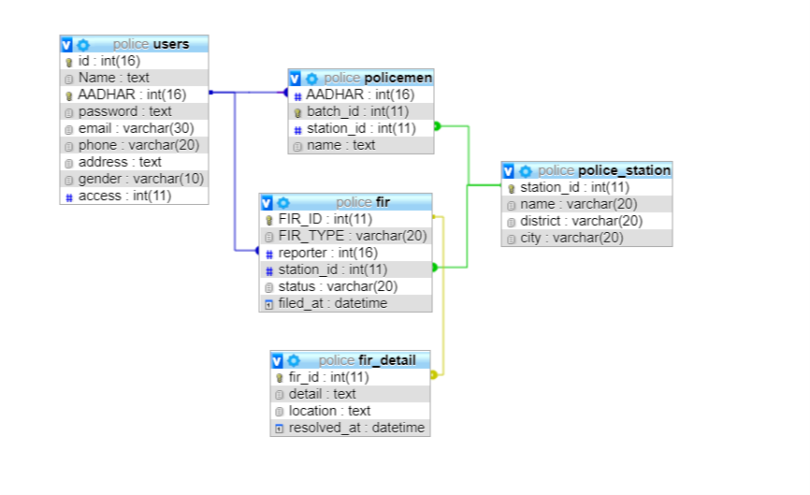
Chapter 4
System Design
4.1 Schema Diagram
Fig 4.1 Schema Diagram

Slide 14
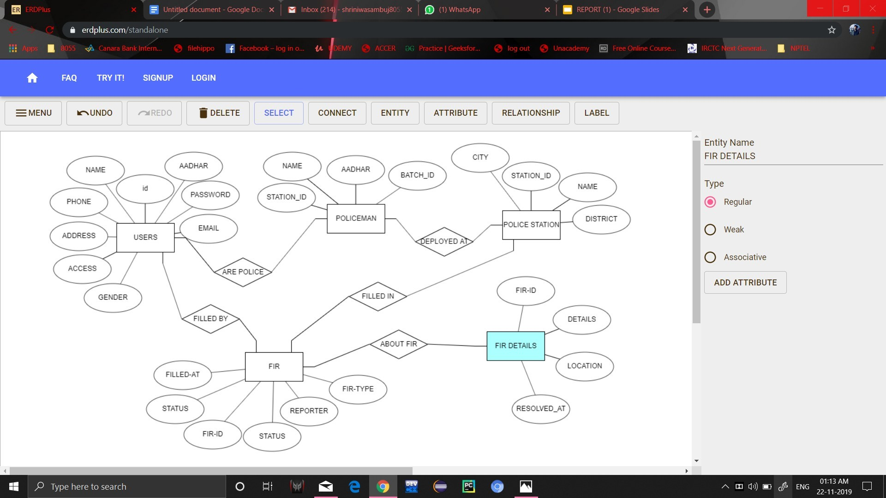
Police Database System
System Design
4.2 ER Diagram
Fig 4.2 ER Diagram for Police Database System
The songs are composed by artists and present in respective albums in the cardinality ratio M:N, songs can be added to the selected playlist which are created by the respective users.
Dept. of CSE, SJBIT
2019-20
Page 9

Slide 15
Chapter 5
Implementation
5.1 HTML5
HTML5 is a markup language used for structuring and presenting content on the World Wide Web. It is the fifth and current major version of the HTML standard.
It was published in October 2014 by the World Wide Web Consortium (W3C) to improve the language with support for the latest multimedia, while keeping it both easily readable by humans and consistently understood by computers and devices such as web browsers, parsers, etc. HTML5 is intended to subsume not only HTML 4, but also XHTML 1 and DOM Level 2 HTML.
HTML5 includes detailed processing models to encourage more interoperable implementations; it extends, improves and rationalizes the markup available for documents, and introduces markup and application programming interfaces (APIs) for complex web applications. For the same reasons,HTML5 is also a candidate for cross-platform mobile applications, because it includes features designed with low-powered devices in mind.
Many new syntactic features are included. To natively include and handle multimedia and graphical content, the new <video>, <audio> and <canvas> elements were added, and support for scalable vector graphics (SVG) content and MathML for mathematical formulas. To enrich the semantic content of documents, new page structure elements such as<main>, <section>, <article>, <header>, <footer>, <aside>, <nav> and <figure>, are added. New attributes are introduced, some elements and attributes have been removed, and others such as <a>, <cite> and<menu> have been changed, redefined or standardized.
The APIs and Document Object Model(DOM) are now fundamental parts of the HTML5 specification and HTML5 also better defines the processing for, any invalid documents.

Slide 16
Police Database System
Implementation
5.2 PHP
PHP is a servlet-side scripting language designed primarily for web development but also used as a general-purpose programming language. Originally created by Rasmus Lerdorf in I994, the PHP reference implementation is now produced by The PHP Development Team. PHP originally stood for Personal Home Page, but it now stands for the recursive acronym PHP: Hypertext Preprocessor.
PHP code may be embedded into HTML or HTML5 markup, or it can be used in combination with various web template systems, web content management
systems and web frameworks. PHP code is usually processed by a PHP interpreter implemented as a module in the web server or as a Common Gateway interface (CGI) executable. The web server software combines the results of the interpreted and executed PHP code, which may beany type of data, including images, with the generated web page. PHP code may also be executed with a command-line interface (CLI) and can be used to implement standalone graphical applications.
The standard PHP interpreter, powered by the Zend Engine, is free software released under the PHP License. PHP has been widely ported and can be deployed on most web servers on almost every operating system and platform, free of charge.
The PHP language evolved without a written formal specification or standard until 2014, leaving the canonical PHP interpreter as a de facto standard. Since 2014 work has gone on to create a formal PHP specification.
PHP is a scripting language that helps people make web pages more interactive by allowing them to do more things.
A website programmed with PHP can have pages that are password protected. A website with no programming cannot do this without other complex things. Standard PHP file extensions are:php,php3 or, phtml, but a web server can be set up to use any extension.
Dept. of CSE, SJBIT
2019-20
Page 11

Slide 17
Police Database System
Implementation
5.3 SQL(Structured Query Language)
SQL (Structured Query Language) is a domain-specific language used in programming and designed for managing data held in a relational database Management system(RDBMS), or for stream processing in a relational data stream management system (RDSMS). In comparison to older read/write APIs like [SAM or VSAM, SQL offers two main advantages : first, it introduced the concept of accessing many records with one single command; and second, it eliminates the need to specify how to reach a record, e.g. with or without an index.
Originally based upon relational algebra and tuple relational calculus, SQL consists of a data definition language, data manipulation language, and data control language. The scope of SQL includes data insert, query, update and delete, schema creation and modification, and data access control. Although SQL is often described as, and to a great extent is, a declarative language (4GL), it also includes procedural elements.
SQL was one of the first commercial languages for Edgar F Codd's relational model, as described in his influential 1970 paper, "A Relational Model of Data for Large Shared DataBanks"
SQL became a standard of the American National Standards Institute(ANSI) in 1986 and of the International Organization for Standardization(ISO) in 1987. Since then, the standard has been revised to include a larger set of features. Despite the existence .of such standards, most SQL code is not completely portable among different database systems without adjustments.
5.4 Code Snippets
5.4.1 Config – To establish connection
This is a code snippet to show how PHP is used to connect to the local MySQL database using the localhost server.
<?php
$mysqlServer = "localhost";
$mysqlDb = "police";
$mysqlUser = "root";
Dept. of CSE, SJBIT
2019-20
Page 12

Slide 18
Police Database System
Implementation
$mysqlPass = "pwdpwd";
$link = mysqli_connect($mysqlServer, $mysqlUser, $mysqlPass,$mysqlDb) or die("ERROR: Failed to connect to DB : ". mysqli_connect_error());
?>
5.4.2 The Login and Register Pages
<?php
session_start();
require_once "config.php";
$error = "";
if (array_key_exists("id", $_COOKIE) && $_COOKIE ['id']) {
$_SESSION['id'] = $_COOKIE['id'];
}
if(isset($_SESSION['id'])) {
header("Location: loggedinpage.php");
}
/*-----------------------SIGNUP----------------------------------------*/
if (array_key_exists("submit", $_POST)) {
if (!$_POST['AADHAR']) {
$error .= "A AADHAR is required<br>";
}
if (!$_POST['password']) {
$error .= "A password is required<br>";
}
if ($error != "") {
$error = "<p>There were error(s) in your form:</p>".$error;
} else {
/*-----------------SIGNUP-duplicate check--------------------------------------*/
if ($_POST['signUp'] == '1') {
$query = "SELECT id FROM `users` WHERE AADHAR = '".mysqli_real_escape_string($link, $_POST['AADHAR'])."' LIMIT 1";
Dept. of CSE, SJBIT
2019-20
Page 13

Slide 19
Police Database System
Implementation
$result = mysqli_query($link, $query);
if (mysqli_num_rows($result) > 0) {
$error = "Account with that AADHAR number already exists.";
} else {
/*------------------------SIGNUP-Insertion--------------------------------------*/
$query = "INSERT INTO `users` (`name`,`AADHAR`, `password`) VALUES ('".mysqli_real_escape_string($link, $_POST['name'])."','".mysqli_real_escape_string($link, $_POST['AADHAR'])."','".mysqli_real_escape_string($link, $_POST['password'])."')";
if (!mysqli_query($link, $query)) {
$error = "<p>Could not sign you up - please try again later.</p>";
/*------------------------SIGNUP-update MD5 hashing-------------------------------*/
} else {
$query = "UPDATE `users` SET password = '".md5(md5(mysqli_insert_id($link)).$_POST['password'])."' WHERE id = ".mysqli_insert_id($link)." LIMIT 1";
mysqli_query($link, $query);
$_SESSION['id'] = mysqli_insert_id($link);
if ($_POST['stayLoggedIn'] == '1') {
setcookie("id", mysqli_insert_id($link), time() + 60*60*24*365);
}
header("Location: loggedinpage.php");
}
}
/*===========================LOGIN=================================*/
} else {
$query = "SELECT * FROM `users` WHERE AADHAR = '".mysqli_real_escape_string($link, $_POST['AADHAR'])."'";
$result = mysqli_query($link, $query);
$row = mysqli_fetch_array($result);
if (isset($row)) {
$hashedPassword = md5(md5($row['id']).$_POST['password']);
Dept. of CSE, SJBIT
2019-20
Page 14

Slide 20
Police Database System
Implementation
if ($hashedPassword == $row['password']) {
$_SESSION['id'] = $row['id'];
if ($_POST['stayLoggedIn'] == '1') {
setcookie("id", $row['id'], time() + 60*60*24*365);
}
header("Location: loggedinpage.php");
} else {
$error = "That AADHAR/password combination Wrong.";
}
} else {
$error = "That AADHAR/password combination could not be found.";
}
}
}
}
?>
================================HTML================================
<div class="col-sm-4">
<center>
<b>SIGNUP/LOGIN</b><br>
<div id="error"><?php if ($error!="") {
echo '<div class="alert alert-danger alert-dismissible fade show" role="alert">'.$error.'</div>';} ?></div><br>
<!--=========================login=========================-->
<form method="post" id="logInForm">
<fieldset class="form-group">
<input type="text" name="AADHAR" placeholder="AADHAR Number" class="form-control" pattern="[0-9]{2}"required>
<small id="emailHelp" class="form-text text-muted">16 digit AADHAR number</small>
</fieldset>
<fieldset class="form-group">
<input type="password" name="password" placeholder="Password" class="form-control" required></fieldset>
<div class="form-group form-check">
<label><input type="checkbox" name="stayLoggedIn" value=1> Stay loggedin</label></div>
<fieldset class="form-group">
<input type="hidden" name="signUp" value="0">
Dept. of CSE, SJBIT
2019-20
Page 15

Slide 21
Police Database System
Implementation
<input type="submit" class="btn btn-success" name="submit" value="Log In!"></fieldset>
<p><a class="toggleForms"><span style="font-weight:normal;">New User ? </span>Sign up</a></p>
</form>
<!--=========================signup=========================-->
<form method="post" id = "signUpForm">
<fieldset class="form-group">
<input type="text" name="name" placeholder="Your Name" class="form-control" required></fieldset>
<fieldset class="form-group">
<input type="text" name="AADHAR" placeholder="Your AADHAR" class="form-control" required></fieldset>
<fieldset class="form-group">
<input type="password" name="password" placeholder="Password" class="form-control" required></fieldset>
<div class="form-group form-check">
<label><input type="checkbox" name="stayLoggedIn" value=1> Stay logged in</label> </div>
<fieldset class="form-group">
<input type="hidden" name="signUp" value="1">
<input type="submit" class="btn btn-success" name="submit" value="Sign Up!"></fieldset>
<p><a class="toggleForms"><span style="font-weight:normal;">Already have an account ? </span>Login</a></p>
</form>
</center>
</div>
5.4.3 Home / Browse Page
<body>
<nav class="navbar navbar-expand-lg fixed-nav-bar navbar-dark bg-dark" id="navbar">
<a class="navbar-brand" id="topleft" href="#"><span style="font-weight:bold">PoliceDB</span></a>
<button class="navbar-toggler" type="button" data-toggle="collapse" data-target="#navbarSupportedContent" aria-controls="navbarSupportedContent" aria-expanded="false" aria-label="Toggle navigation">
<span class="navbar-toggler-icon"></span>
</button>
Dept. of CSE, SJBIT
2019-20
Page 16

Slide 22
Police Database System
Implementation
<div class="navbar-nav navbar-collapse mr-auto" id="wel"> welcome,<?php
$result = mysqli_query($link,"SELECT Name FROM users where id=$iid");
while($row = mysqli_fetch_array($result, MYSQLI_ASSOC))
{echo " ".$row["Name"];}?> <a href="profile.php">&nbsp;edit</a>
</div>
<div class="collapse navbar-collapse" id="navbarSupportedContent">
<ul class="navbar-nav mr-auto">
<li class="nav-item active">
<a class="nav-link" href="index.php">Home <span class="sr-only">(current)</span></a>
</li>
<li class="nav-item">
<a class="nav-link" href="contact.php">Contact Us</a>
</li>
<li class="nav-item">
<a class="nav-link" href="about.php">About</a>
</li>
<li class="nav-item">
<a class="nav-link" href='logout.php'>Log out</a>
</li> </ul></div> </nav>
<div id="content" class="container-fluid">
<input type="text" id="myInput" onkeyup="myFunction()" placeholder="Search for id..">
<input type="button" class="btn btn-primary" id="Fir" value="ADD FIR" style="margin:10px">
<input type="button" class="btn btn-primary admin" id="Police" value="ADD POLICE" style="margin:10px">
<input type="button" class="btn btn-primary" id="shFir" value="SHOW FIR" style="margin:10px">
<input type="button" class="btn btn-primary admin" id="shPolice" value="SHOW POLICE" style="margin:10px">
<div id="firtable">
Dept. of CSE, SJBIT
2019-20
Page 17

Slide 23
Police Database System
Implementation
<table class="table table-striped" id="myTable">
<thead>
<th>FIR_id</th>
<th>FIR_Type</th>
<th>Reporter</th>
<th>Station_id</th>
<th>Status</th>
<th>Details</th>
</thead>
<?php
if($priv<1){
$result = mysqli_query($link,"SELECT * FROM fir where Reporter = $ad ");}
else{
$result = mysqli_query($link,"SELECT * FROM fir");
}
while($row = mysqli_fetch_array($result, MYSQLI_ASSOC))
{
echo "<tr>
<td>".$row["FIR_ID"]."</td>
<td>".$row["FIR_TYPE"]."</td>
<td>".$row["reporter"]."</td>
<td>".$row["station_id"]."</td>
<td>".$row["status"]."</td>
<td><a href='firdetails.php/?firid=".$row["FIR_ID"]."'>Details</a></td>
</tr>";
}
?>
</table>
</div>
Dept. of CSE, SJBIT
2019-20
Page 18

Slide 24
Police Database System
Implementation
5.4.5 Search Page
<div id="content" class="container-fluid">
<input type="text" id="myInput" onkeyup="myFunction()" placeholder="Search for id..">
<script>
function myFunction() {
var input, filter, table, tr, td, i, txtValue;
input = document.getElementById("myInput");
filter = input.value.toUpperCase();
table = document.getElementById("myTable");
tr = table.getElementsByTagName("tr");
for (i = 0; i < tr.length; i++) {
td = tr[i].getElementsByTagName("td")[0];
if (td) {
txtValue = td.textContent || td.innerText;
if (txtValue.toUpperCase().indexOf(filter) > -1) {
tr[i].style.display = "";
} else {
tr[i].style.display = "none";
}
}
}
}
</script>
Dept. of CSE, SJBIT
2019-20
Page 19

Slide 25
Police Database System
Implementation
5.4.6 Profile Page
<form method="post" action="profile.php">
<div class="form-group">
<label>AADHAR:</label>
<input type="text" class="form-control" value="<?php echo $ad; ?>" name="fir" readonly>
</div>
<div class="form-group">
<label>Name:</label>
<input type="text" class="form-control" value="<?php echo $na; ?>" name="name">
</div>
<div class="form-group">
<label>E-mail:</label>
<input type="email" class="form-control" value="<?php echo $em; ?>" name="email">
</div>
<div class="form-group">
<label>Phone Number:</label>
<input type="tel" class="form-control" value="<?php echo $ph; ?>" name="phone" pattern="[0-9]{3}-[0-9]{3}-[0-9]{4}">
<small>Format: 123-456-7890</small>
</div>
<div class="form-group">
<label>Address:</label>
<textarea type="text" class="form-control" name="addr" value="<?php echo $add; ?>" rows="3"></textarea>
</div>
<div class="form-check">
<label>Gender:</label><br>
<label class="radio-inline"><input type="radio" name="gender" value="Male"> Male </label>
Dept. of CSE, SJBIT
2019-20
Page 20

Slide 26
Police Database System
Implementation
<label class="radio-inline"><input type="radio" name="gender" value="Female"> Female </label>
<label class="radio-inline"><input type="radio" name="gender" value="other"> Other</label>
</div><br>
<button type="submit" name="profile" class="btn btn-success">Submit</button> <button class="btn btn-info"><a style="color:white" href="loggedinpage.php">BACK</a></button>
</form>
5.4.7 FIR Page
<form method="post" action="firentry.php">
<div class="form-group">
<label for="exampleInputEmail1">FIR_TYPE</label>
<input type="text" class="form-control" placeholder="fir-type" name="fir" required></div>
<div class="form-group">
<label for="exampleInputPassword1">Station_id</label>
<input type="text" class="form-control"placeholder="station-id" name="station" required></div>
<div class="form-group">
<label for="exampleInputPassword1">Location:</label>
<input type="text" class="form-control" placeholder="location" name="location" required> </div>
<div class="form-group">
<label for="exampleInputPassword1">date-time:</label>
<input type="datetime-local" class="form-control" placeholder="" name="firtime" required>
</div>
Dept. of CSE, SJBIT
2019-20
Page 21

Slide 27
Police Database System
Implementation
<div class="form-group">
<label for="Password1">detail</label>
<textarea class="form-control" placeholder="Detail" name="details" rows="3" required></textarea>
</div>
<button type="submit" name="fentry" class="btn btn-success">Submit</button>
</form>
<?php
$datet=date("Y-m-d H:i:s", strtotime($_POST["firtime"]));
echo $datet;
if(array_key_exists("fentry", $_POST)){
$query1 = "INSERT INTO `fir` (`FIR_TYPE`, `reporter`, `station_id`,`filed_at`) VALUES ('".$_POST["fir"]."', ".$ad.", ".$_POST["station"].",'".$datet."')";
if(!mysqli_query($link, $query1)){
echo "entry problem";
}
else{
$query2 = "INSERT INTO `fir_detail` (`fir_id`, `detail`, `location`) VALUES ('".mysqli_insert_id($link)."', '".$_POST["details"]."', '".$_POST["location"]."')";
if(!mysqli_query($link, $query2)){
echo "entry problem in details";}else{
header("Location: loggedinpage.php");}
}
}
?>
Dept. of CSE, SJBIT
2019-20
Page 22

Slide 28
Police Database System
Implementation
5.4.7 Police Entry Page
<?php
if(array_key_exists("pentry", $_POST)){
$querycheck = "SELECT name FROM `policemen` WHERE AADHAR = ".$_POST['aadhar'];
$result = mysqli_query($link, $querycheck);
if (mysqli_num_rows($result) > 0) {
echo "<center id='content'>Already a Police<br><a href='loggedinpage.php'><-back</a></center>";
}
else{
$query1 = "INSERT INTO `policemen` (`AADHAR`, `batch_id`, `station_id`, `name`) VALUES (".$_POST["aadhar"].", ".$_POST["batch"].", ".$_POST["station"].", '".$_POST["name"]."')";
$query2 = "UPDATE `users` SET `access`=1 WHERE `AADHAR` = ".$_POST["aadhar"];
if(!mysqli_query($link, $query1) || !mysqli_query($link, $query2)){
echo "<center id='content'>entry problem<br><a href='loggedinpage.php'><-back</a></center>";
}
else{
header("Location: loggedinpage.php");
} }
}else{
header("Location: loggedinpage.php");
}
?>
<form method="post" action="policeentry.php">
<div class="form-group">
<label for="exampleInputEmail1">aadhar</label>
Dept. of CSE, SJBIT
2019-20
Page 23

Slide 29
Police Database System
Implementation
<input type="text" class="form-control" placeholder="AADHAR" name="aadhar" required>
</div>
<div class="form-group">
<label for="Batch">batch ID</label>
<input type="text" class="form-control" placeholder="Batch ID" name="batch" required>
</div>
<div class="form-group">
<label for="station_ID">station ID</label>
<input type="text" class="form-control" placeholder="Station ID" name="station" required>
</div>
<div class="form-group">
<label for="Name">Name</label>
<input type="text" class="form-control" placeholder="NAME" name="name" required>
</div>
<button type="submit" name="pentry" class="btn btn-success">Submit</button>
</form>
Dept. of CSE, SJBIT
2019-20
Page 24

Slide 30
Police Database System
Implementation
5.4.9 Log Out Page
<?php
// Initialize the session
session_start();
// Unset all of the session variables
$_SESSION = array();
setcookie("id", "", time() - 60*60);
$_COOKIE['id'] = "";
session_destroy();
// Redirect to login page
header("location: index.php");
exit;
?>
Dept. of CSE, SJBIT
2019-20
Page 25

Slide 31
Police Database System
Implementation
5.4.10 Stored Procedure
This procedure is implemented to either update or insert into the Albums page , based on whether an Album is already present the table or not. If the result is already present, then an UPDATE operation is carried out.
DELIMITER $$
CREATE DEFINER=`root`@`localhost` PROCEDURE `GetPolice`()
BEGIN
SELECT * FROM `policemen`;
END$$
DELIMITER ;
5.4.11 Triggered Action
Resolved_at update: Whenever a FIR is resolved, it inserts the timestamp in the database in resolved_at column when there is any update in FIR status.
CREATE TRIGGER `res` AFTER UPDATE ON `fir`
FOR EACH ROW UPDATE `fir_detail` SET `resolved_at`=NOW() WHERE fir_id=NEW.fir_id
Dept. of CSE, SJBIT
2019-20
Page 26

Slide 32
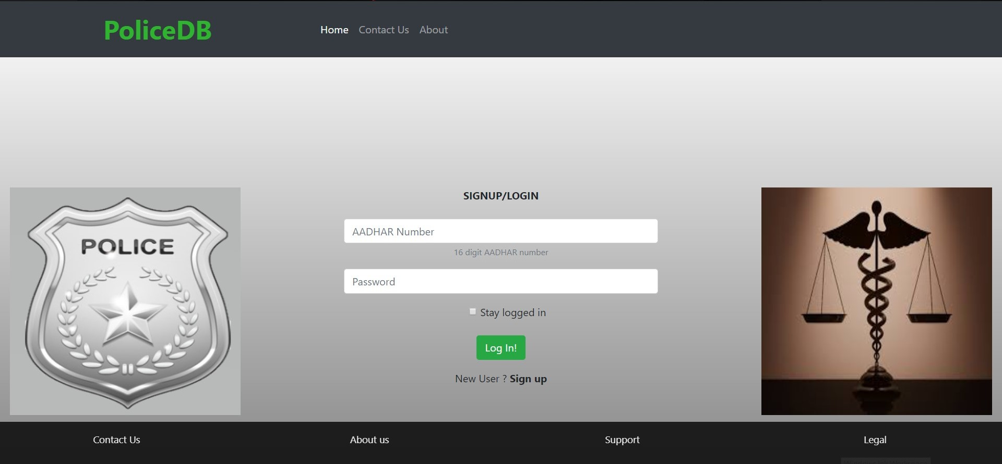
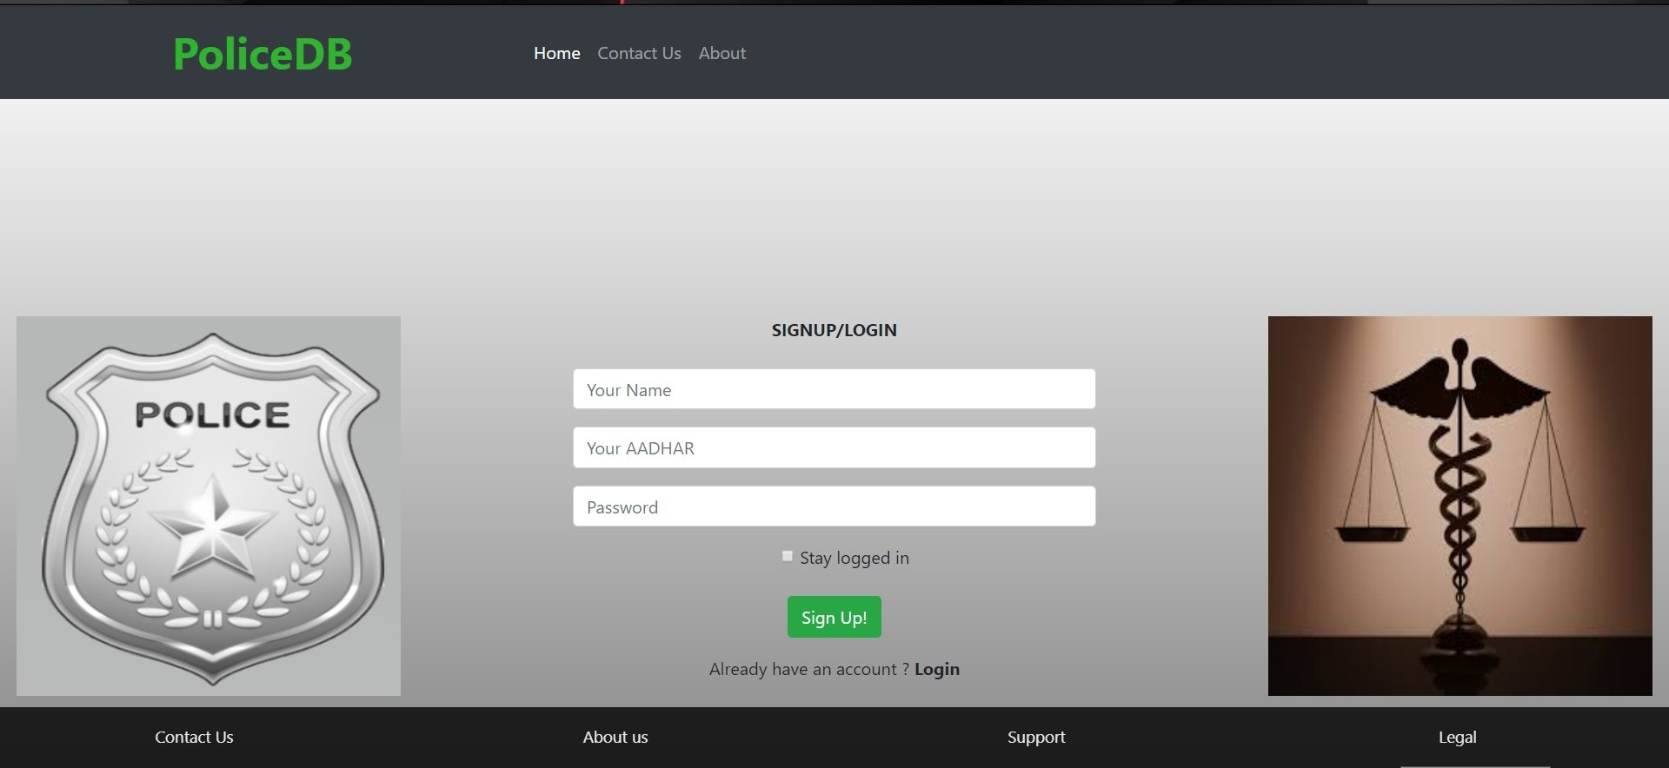
Chapter 6
Snapshots
6.1 The Login and Register Page
This is the users Login page, the registered users can have access to this, which will navigate them to the police station home page, else they can click the register button to get user registration.
Fig 6.1.1 Login Page
Fig 6.1.2 Register Page

Slide 33
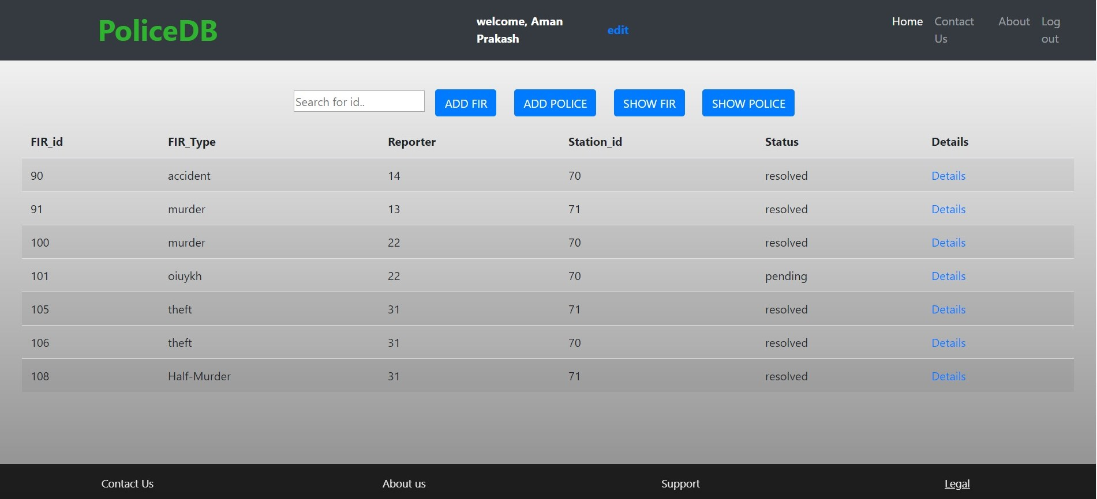
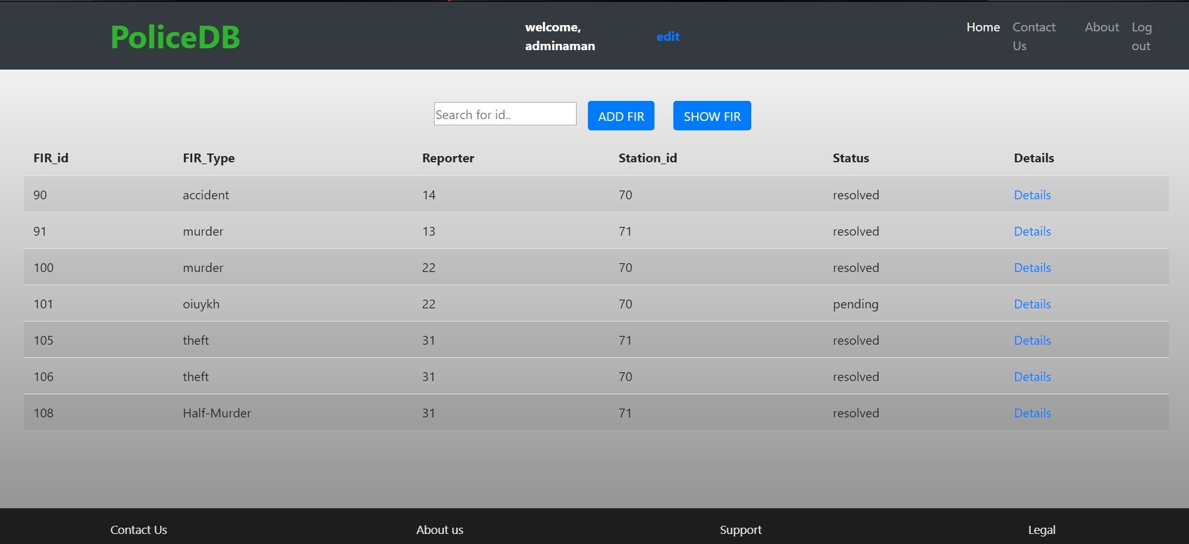
Police Database System
Snapshots
6.2 The Browse/Home Page
The Browse page is the page to which the user will be navigated once he logs into his account.
Fig 6.2 Admin Home Page
6.3 User Home Page
Fig 6.3 User Home Page
Dept. of CSE, SJBIT
2019-20
Page 28

Slide 34

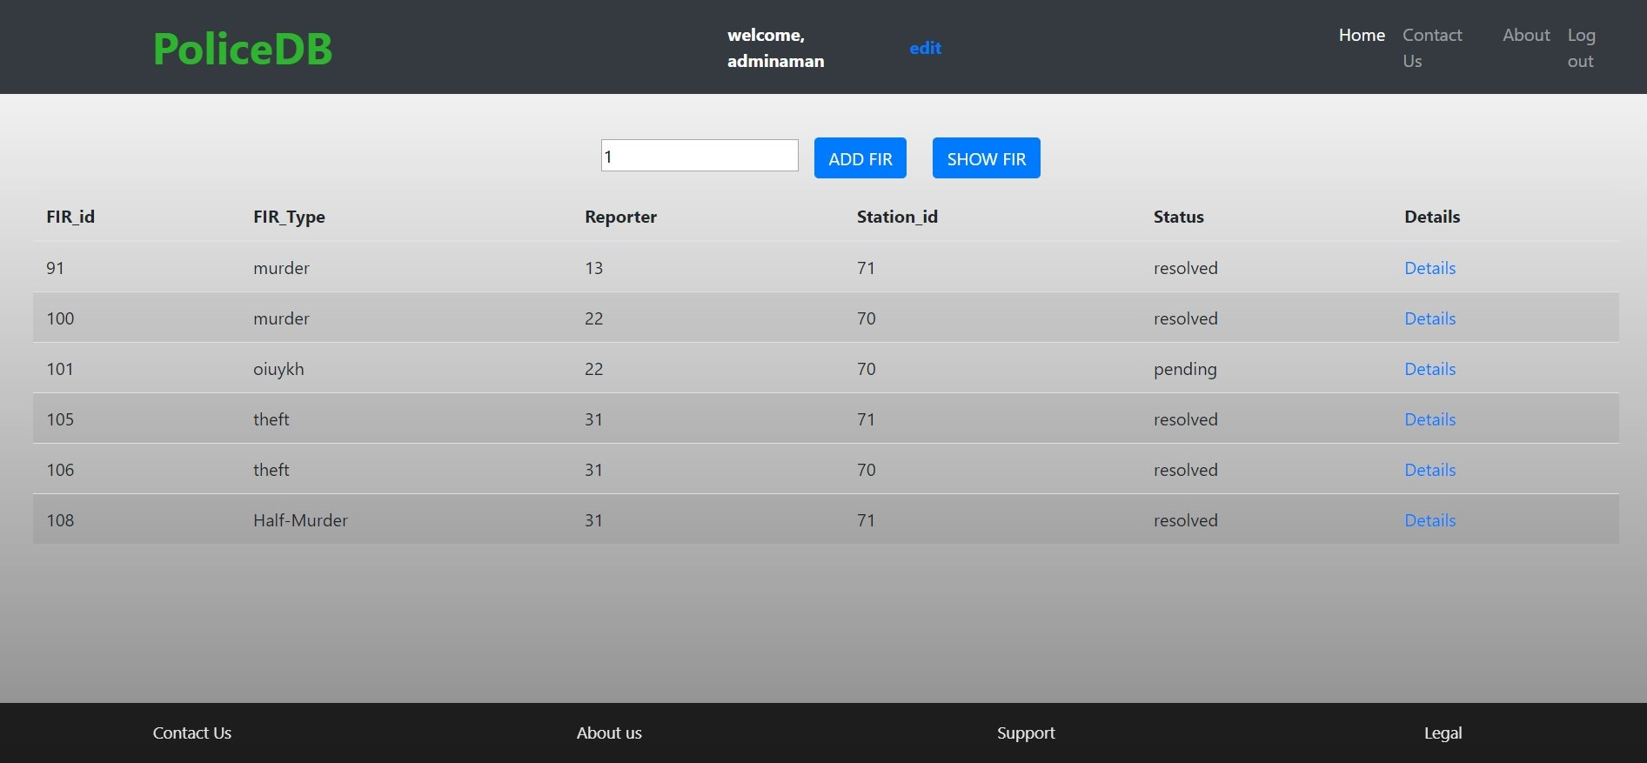
Police Database System
Snapshots
6.4 Admin Search Page
The Fir-list page contains all the Fir-list that are created by the Admin.
Fig 6.4 Admin Search Page
6.5 User Search Page
The Fir-list page contains all the Fir-list that are created by the respective User.
Fig 6.5 User Search Page
Dept. of CSE, SJBIT
2019-20
Page 29

Slide 35
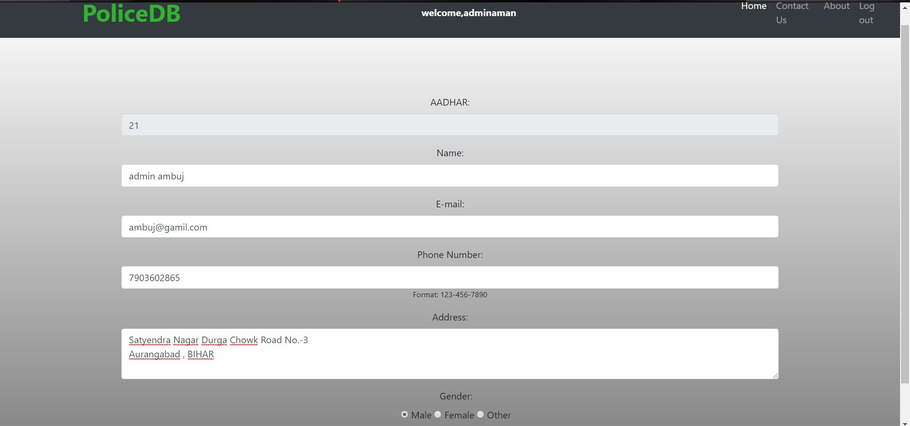
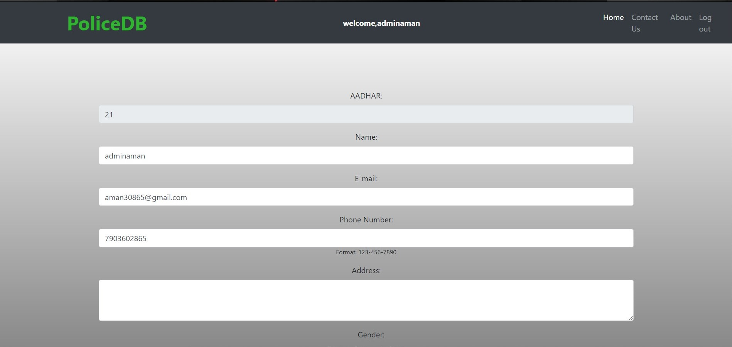
Police Database System
Snapshots
6.6 Admin Edit Page
Fig 6.6 Admin Edit Page
6.7 User Edit Page
Fig 6.7 User Edit Page
Dept. of CSE, SJBIT
2019-20
Page 30

Slide 36
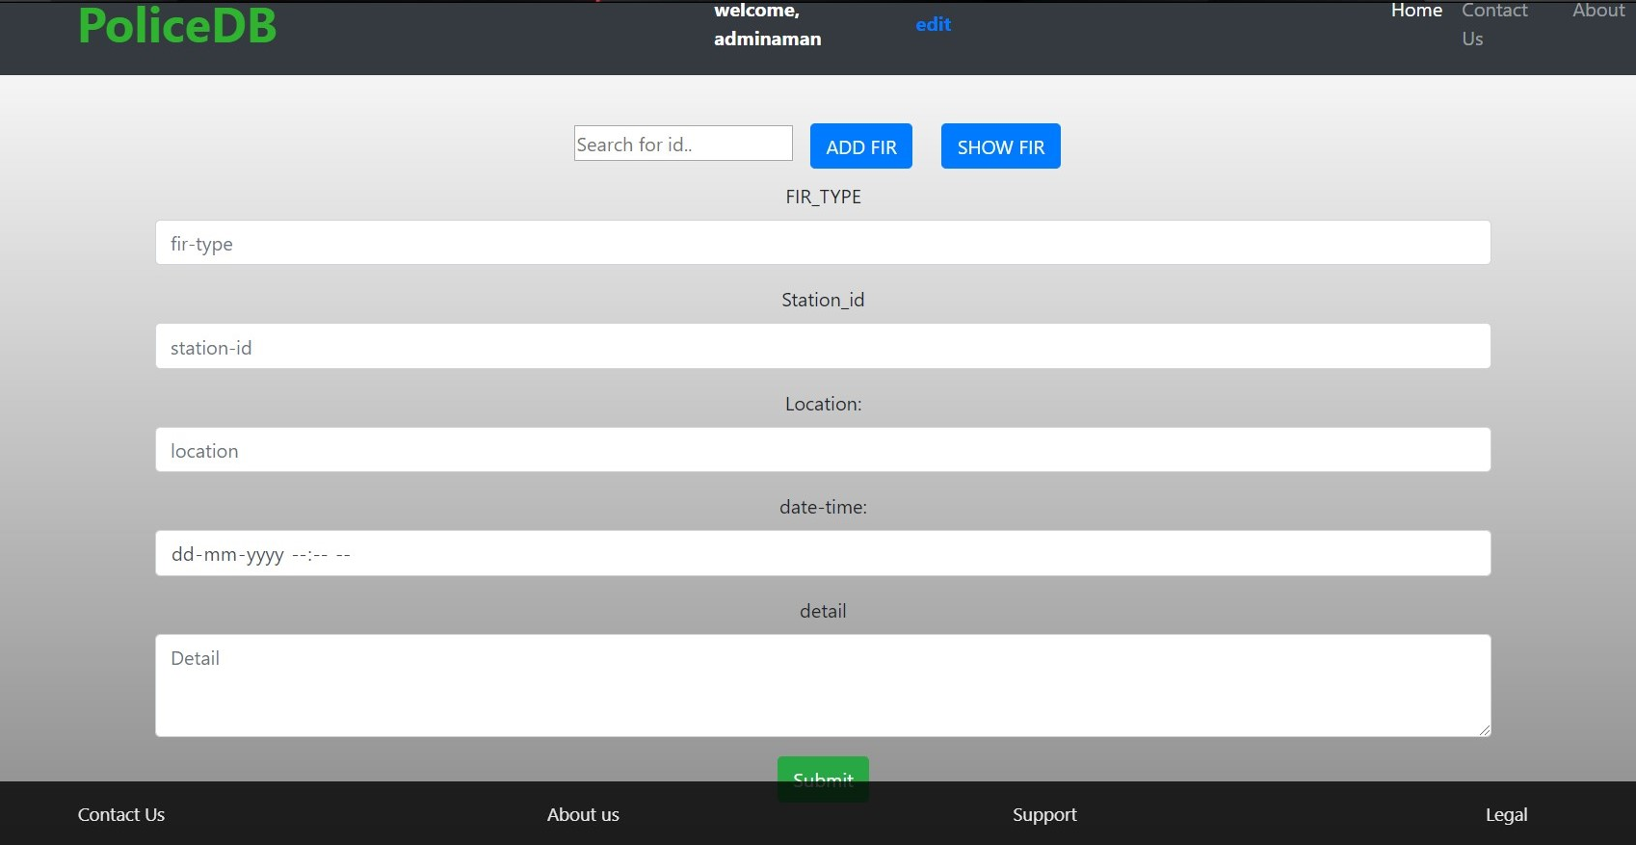
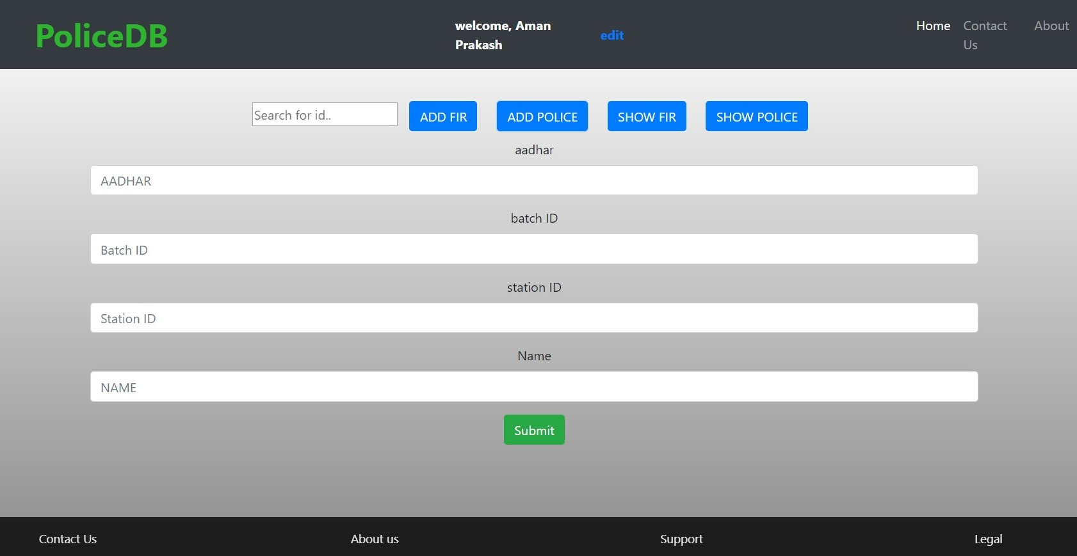
Police Database System
Snapshots
6.8 Add FIR
Fig 6.8 Add FIR
6.9 Add Police
Fig 6.9 Add Police
Dept. of CSE, SJBIT
2019-20
Page 31

Slide 37
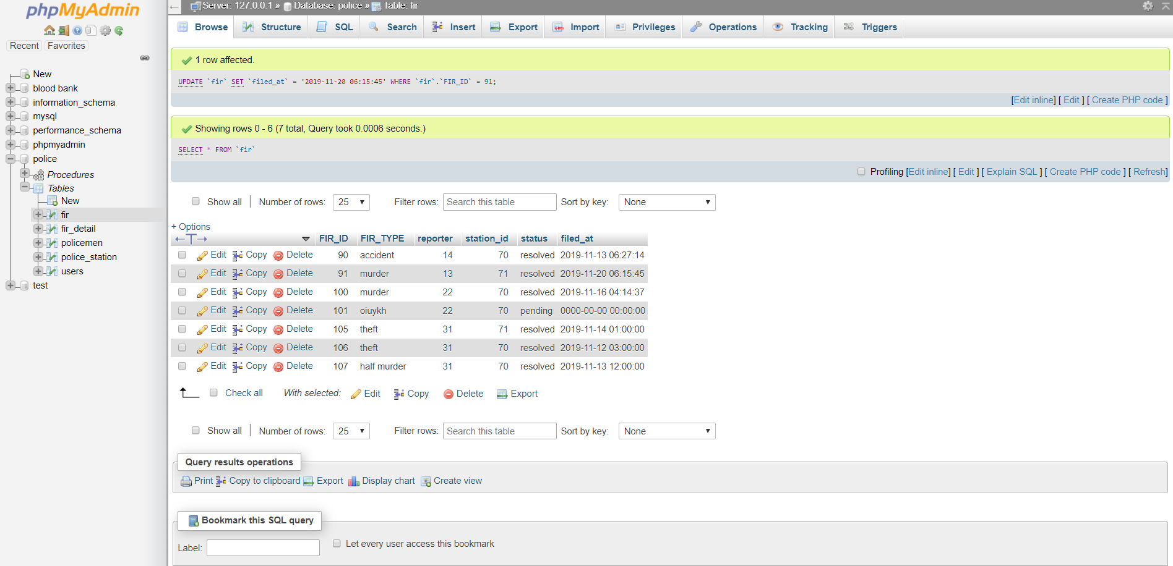
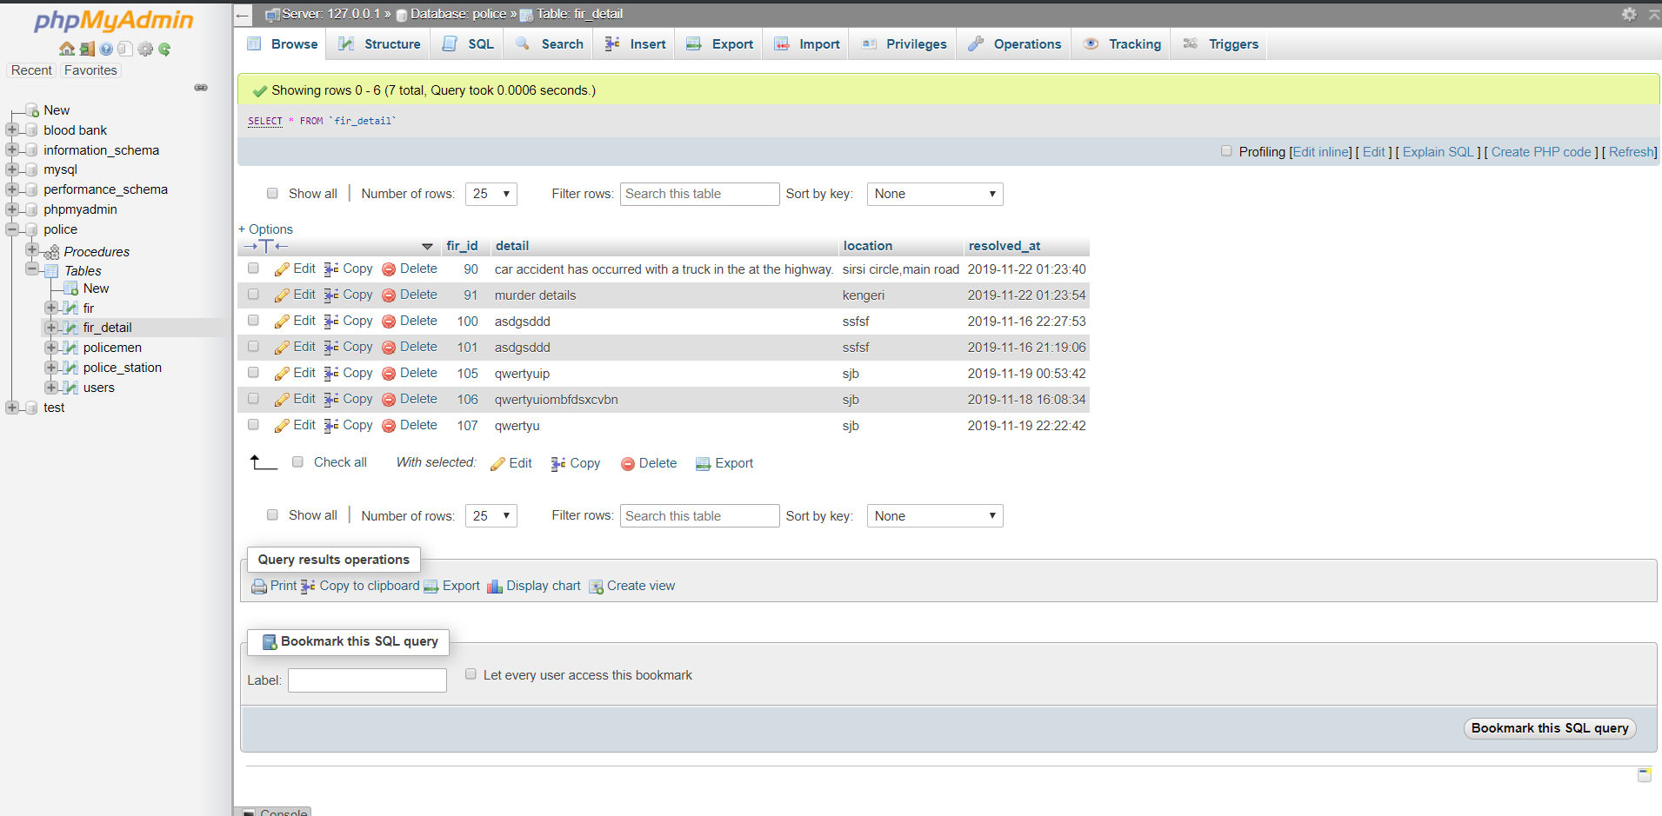
Police Database System
Snapshots
6.8 Tables
Table 6-1 FIR Table
Table 6-2 FIR details Table
Dept. of CSE, SJBIT
2019-20
Page 32

Slide 38
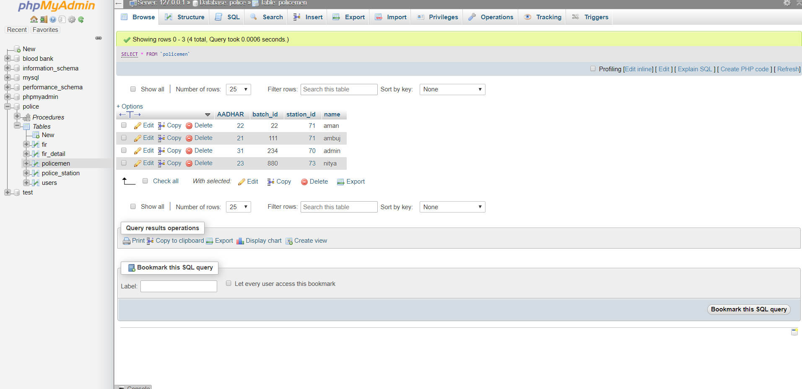
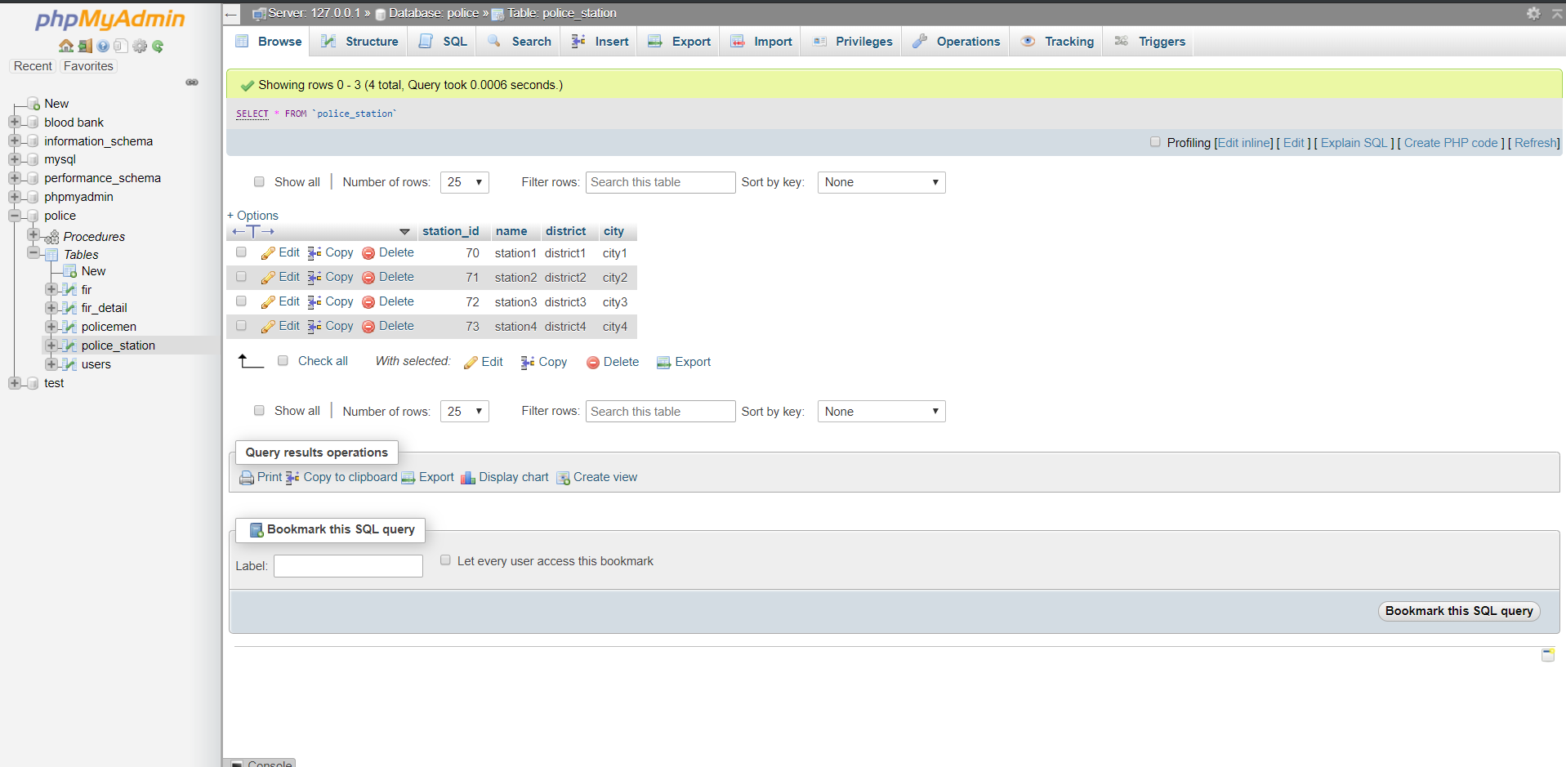
Police Database System
Snapshots
Table 6-3 Policemen Table
Table 6-4 Police station Table
Dept. of CSE, SJBIT
2019-20
Page 33

Slide 39
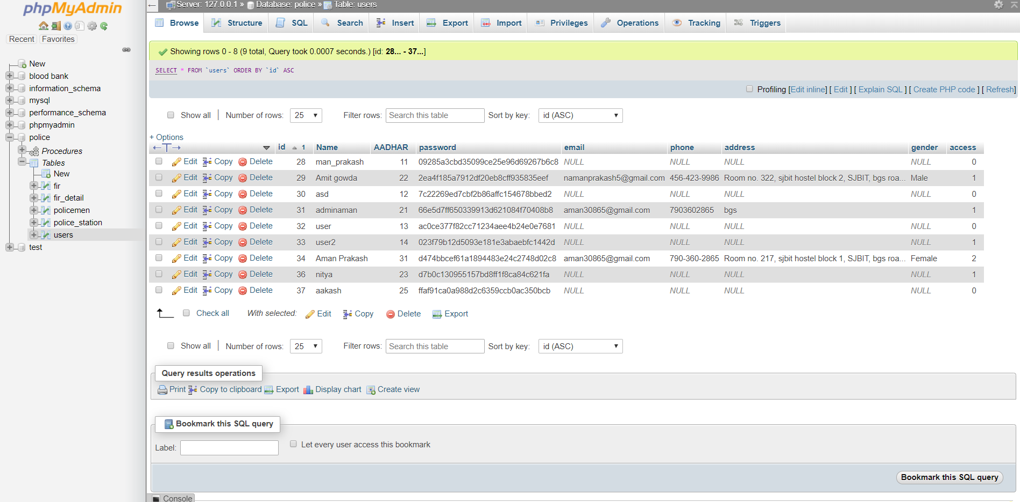
Police Database System
Snapshots
Table 6-5 Users Table
Dept. of CSE, SJBIT
2019-20
Page 34

Slide 40
Chapter 7
Conclusion
With the theoretical knowledge of this subject we created “Police Database System” thereby also gained a practical experience about how to create and develop a project which was necessary factor for all the students. It becomes very necessary to take the utmost advantage of any opportunity of gaining practical knowledge that comes along. The construction of this mini project was one of these opportunities.
The motive of this project was to provide the user a great experience of police services and to maintain all the FIR records and police records. We tried to some extent in order to reach our motive, it can be still increased by doing with future iterations of this project.

Slide 41
References
[1]. The Bootstrap Website (for Design) – https://getbootstrap.com/
[2]. W3 Schools (HTML, CSS and PHP reference) – https://www.w3schools.com/
[3]. PHP Official Documentation – https://php.net/docs.php/
[4]. The MySQL Documentation – https://dev.mysql.com/doc/
[5]. Stack Overflow – https://stackoverflow.com/
[6]. Stack Exchange – https://stackexchange.com/

